Slide 1
CASE STUDY
Problem Statement: To build a machine learning model that will predict selling price of the cars.

Slide 2
Data Set Description:
Training dataset shape (5000,13)
Test dataset shape (1925,13)
Features | Description | Missing Values-Training
Name | Car Company and model name | null
Year | Manufacturing Year | null
Km_Driven | Km Driven in Total | null
Fuel | Diesel/Petrol/LPG/CNG | null
Seller_type | Individual/Dealer/Trustmark Dealer | null
Transmission | Manual/Automatic | null
Owner | First Owner/ Second Owner/ Third Owner/Fourth & Above Owner/ Test Drive Car | null
Mileage | Mileage in kmpl | 149
Engine | Engine cubic capacity | 149
MaxPower | Max horse Power | 146
Torque | Torque in Nm @Rpm | 150
Seats | Total Seating Capacity | 149
Selling Price | Selling Price of Car (Dependent Variable) | null

Slide 3
Data Type Transformation and Handling Missing Values(1/2)
Engine – Removing Units and Converting to float
Max Power –Removing Units and Converting to float
Mileage – Removing Units and Converting to float
Name – Splitting into company Name and Model Name

Slide 4
Data Type Transformation and Handling Missing Values(2/2)
Grouping by the company name and filling the mean values
df["mileage"] = df.groupby("company")['mileage'].transform(lambda x:
x.fillna(x.mean()))

Slide 5
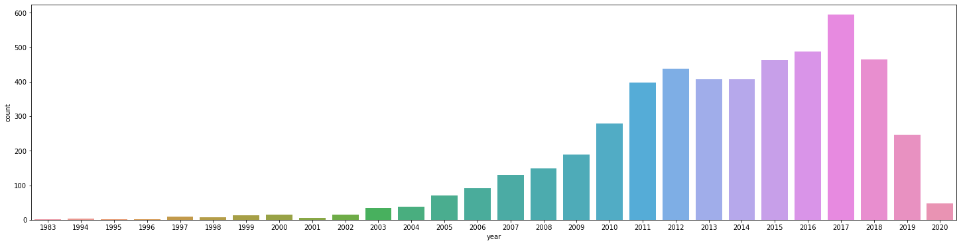
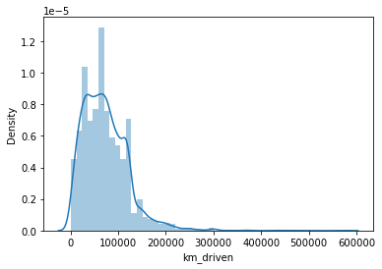
Outliers
Removing rows having year less than 2002

Slide 6
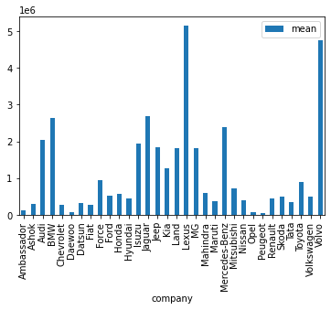
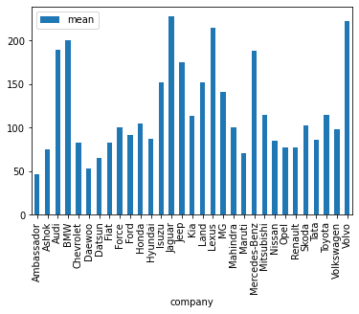
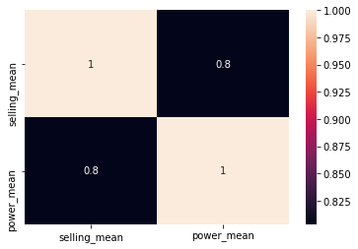
Correlation between Company’s average selling price and average Max-Power
Average Selling Price
Average Max-Power

Slide 7
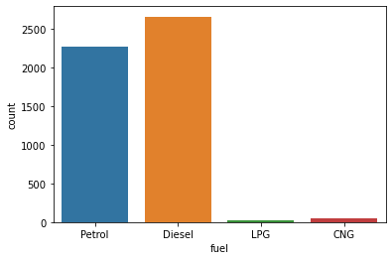
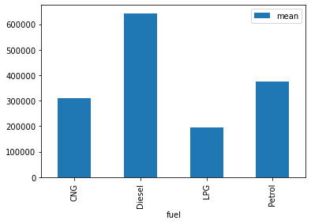
Average Selling Price

Slide 8
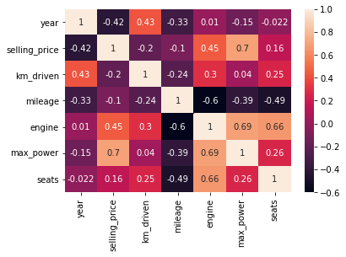
Collinearity

Slide 9
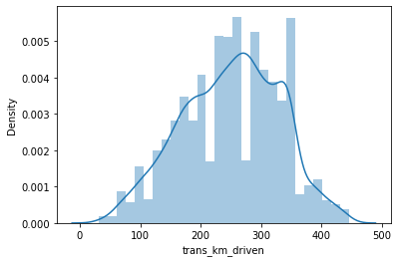
Skewness
np.sqrt()

Slide 10
Encoding of Categorical Variables
Encode the features- Owner ,Transmission , Fuel
Dropping the company column and did a target encoding for it and therefore added a variable name derived in the dataset
Year = (current year-year)

Slide 11
Removing Redundant Variables
Dropped features -Seller Type ,Torque ,Company ,Model Name and Engine

Slide 12
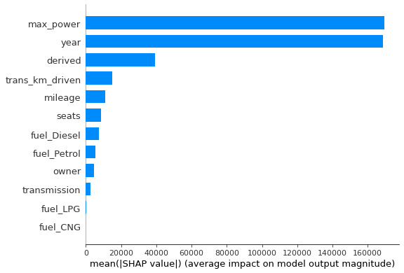
Random Forest
Metric | Result
Root Mean Squared Error | 155621
R squared Score | 0.90
Accuracy (100-mape) | 82.18%

Slide 13
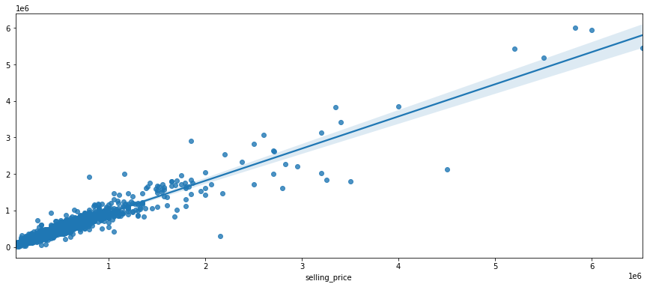
XG-BOOST
Metric | Result
RMSE | 149638
R squared Score | 0.91
Accuracy (100-mape) | 82.56%
Predicted

Slide 14
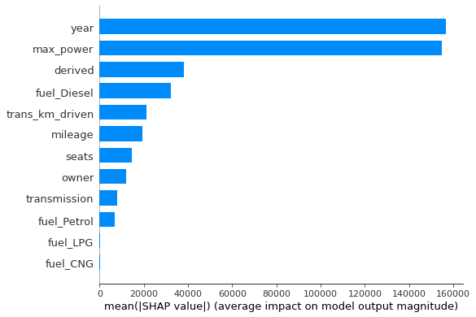
Feature Importance(XG -Boost)

Slide 15
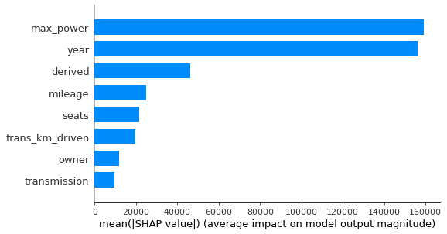
Feature Importance(Dropping Fuel variable)
RMSE- 150481

Slide 16
THANK YOU
TANISH BOTHRA

